Slide 1
Structure of Polymer Chain:
Introduction to chain conformation, configurations, isomerism and stereochemistry. Origin and types of stereoisomerism in polymers; factors influencing stereo-regulation, Conformation of Polymer Chain.

Slide 2
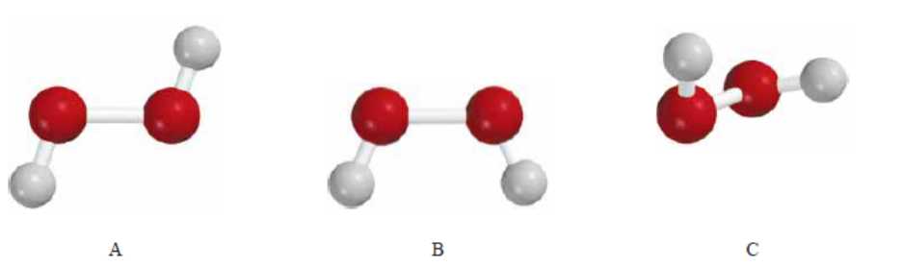
Introduction to chain conformation, configurations, isomerism and stereochemistry
Chain conformation
Conformations are different spatial arrangements of a molecule that are generated by rotation about single bonds.

Slide 3
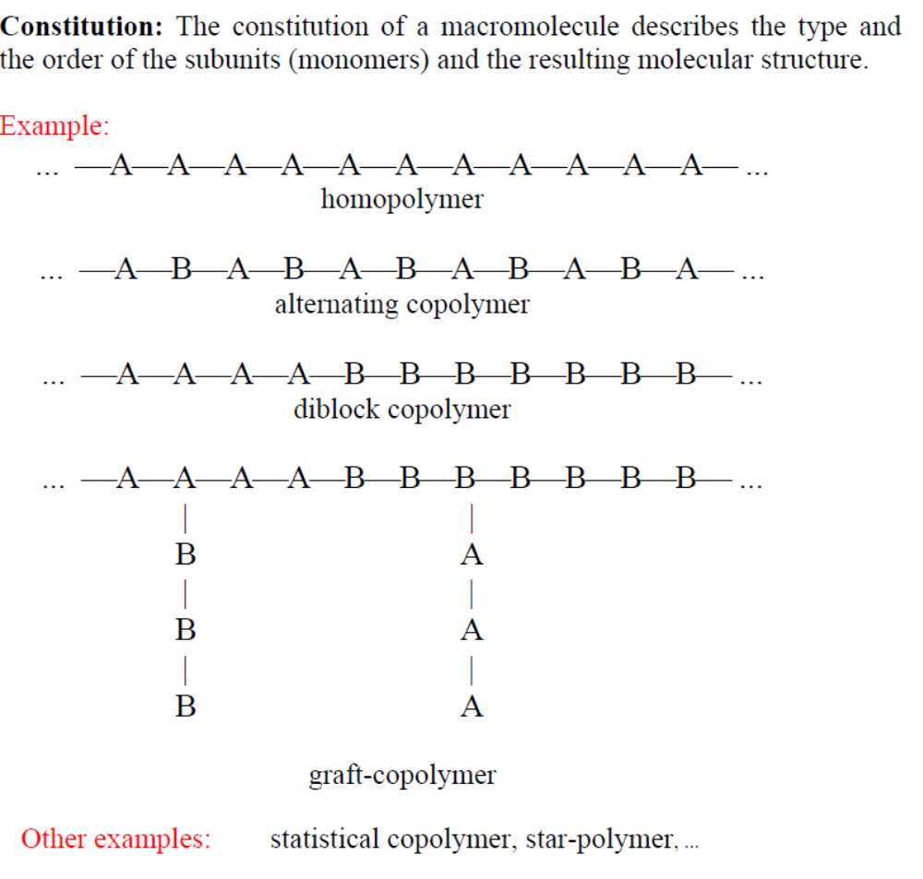

Slide 4
Conformation
Conformation refers to order that arises from the rotation of molecules about the single bonds
thermal fluctuation of the bond length (3%) and bond angle (3-5°) are small at room temperature
rotations around the bonds are well possible

Slide 5
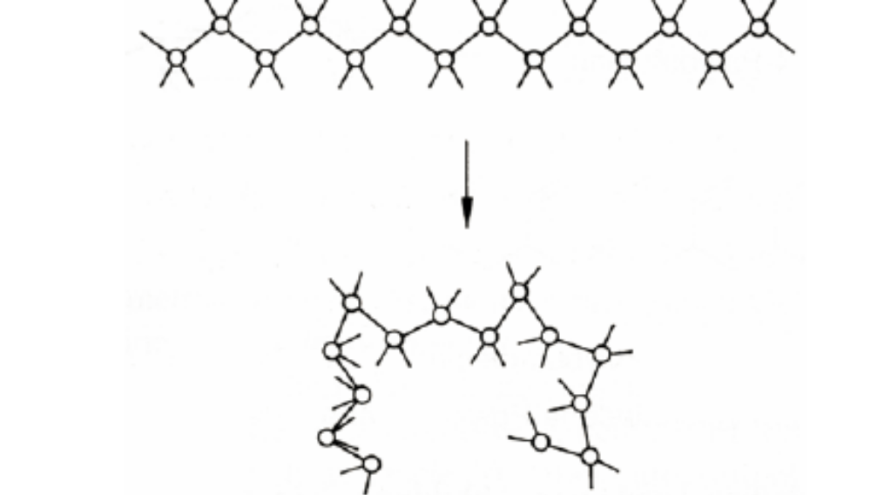
Conformation
Example: Well flexible macromolecule ⇔ back-folded chain

Slide 6
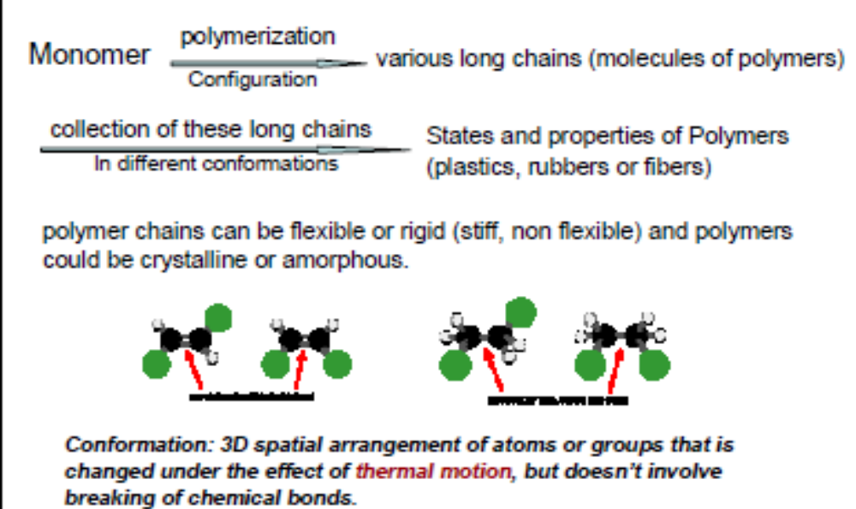

Slide 7
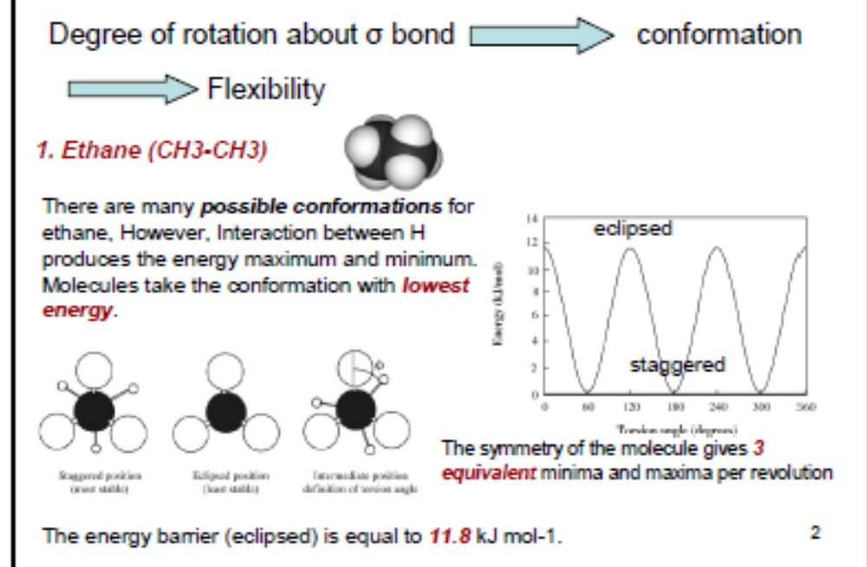
Flexibility mechanism

Slide 8
CONFORMATIONAL ANALYSIS OF ETHANE
Ethane is the simplest hydrocarbon that can have distinct conformations. Two, the
staggered conformation and the eclipsed conformation, deserve special attention.
The C-H bonds in the staggered conformation are arranged
so that each one bisects the angle made by a pair of C-H bonds on the adjacent carbon.
In the eclipsed conformation each C-H bond is aligned with a C-H bond on the adjacent carbon. The staggered and eclipsed conformations interconvert by rotation around the carbonÐcarbon bond. Different conformations of the same molecule are sometimes called conformers or rotamers.

Slide 9
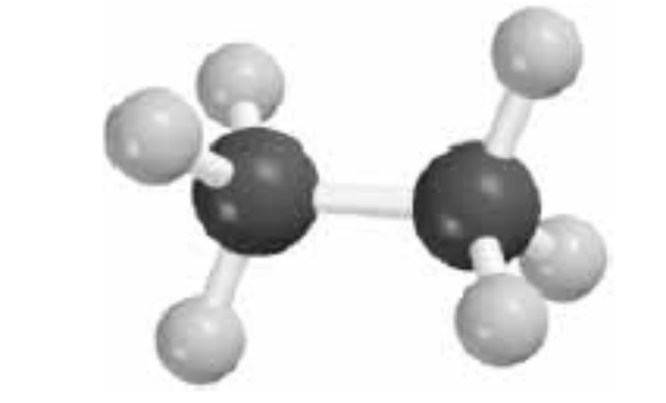
Staggered conformation of ethane

Slide 10
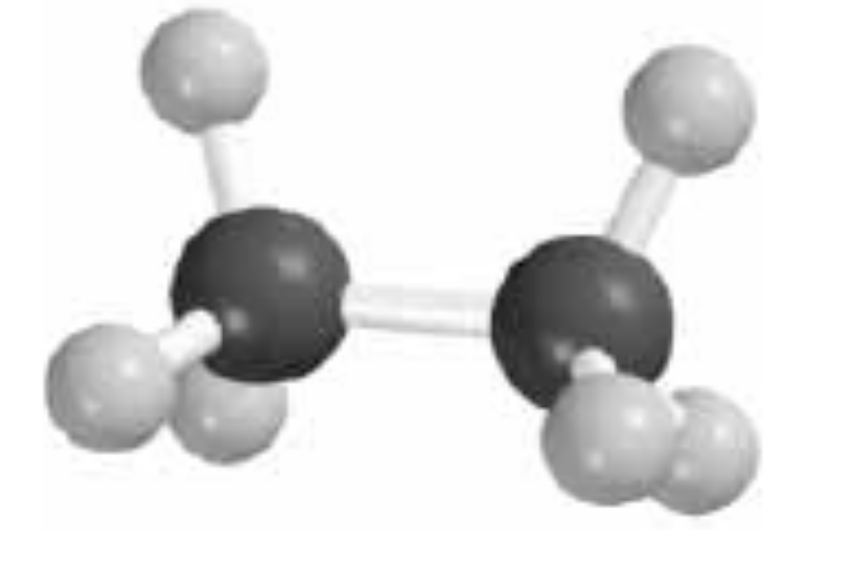
Eclipsed conformation of ethane

Slide 11
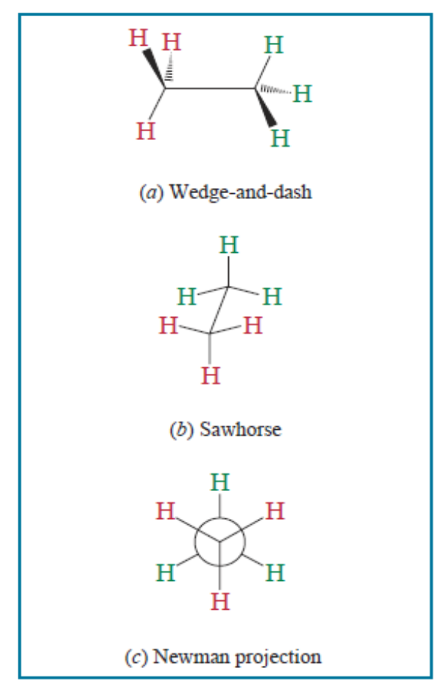
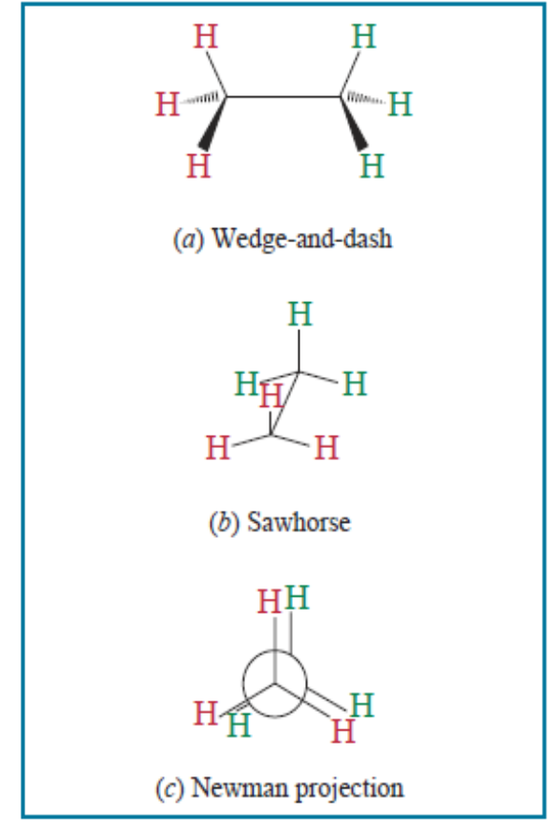
Some commonly used representations
of the staggered conformation
of ethane.
Some commonly used representations
of the eclipsed conformation
of ethane.

Slide 12
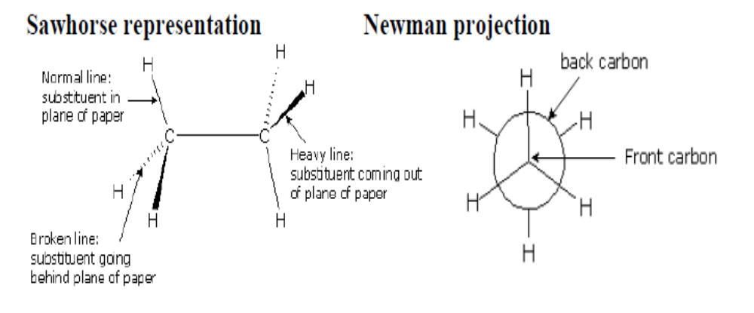
Sawhorse representation: The spatial orientation are indicated by employing heavy tapered lines for substituents coming out of the page, normal lines for substituents in the plane of the page, and dashed lines for substituents going back behind the plane of the page.
Newman projection: in this representation one views the carbon-carbon bond directly end-on and represents the two carbon atoms by a circle. Lines going to the center of the circle represent substituents on the front carbon, and lines going to the edge of the circle represent substituents on the rear carbon.

Slide 13
The structural feature that above figures illustrate is the spatial relationship between atoms on adjacent carbon atoms.
Each H-C-C-H unit in ethane is characterized by a torsion angle or dihedral angle, which is the angle between the H-C-C plane and the C-C-H plane.
The torsion angle is easily seen in a Newman projection of ethane as the angle between C-H bonds of adjacent carbons.

Slide 14
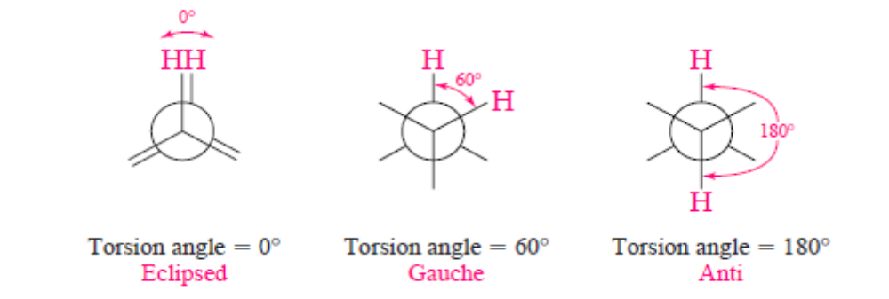
Torsion Angle
Eclipsed bonds are characterized by a torsion angle of 0°. When the torsion angle is approximately 60°, we say that the spatial relationship is gauche; and when it is 180° we say that it is anti. Staggered conformations have only gauche or anti relationships between bonds on adjacent atoms.

Slide 15
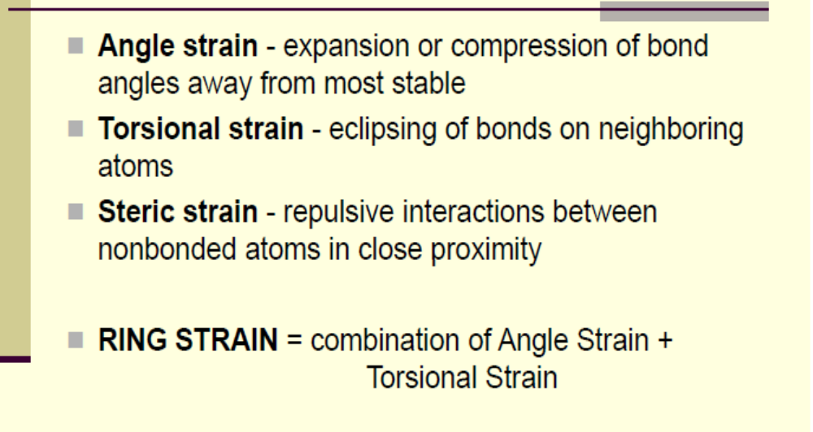
Types of Strain

Slide 16
Torsional Strain Energy
Force that opposes rotation due to the repulsion of bonding electrons
We do not observe perfectly free rotation
There is a barrier to rotation, and some
conformers are more stable than others
Small energy barrier easily overcome at RT
Each eclipsed H-H costs 4 kJ/mol of Torsional Energy

Slide 17
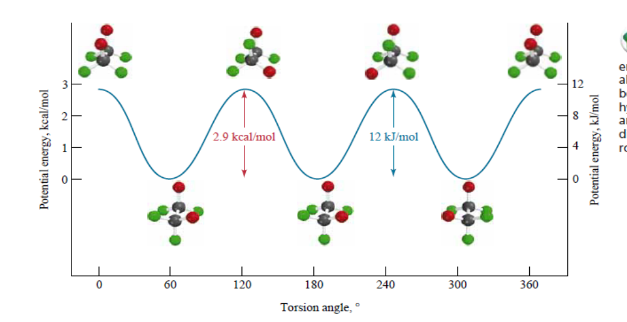
Potential energy diagram
Potential energy diagram for rotation about the carbon – carbon bond in ethane. Two of the hydrogens are shown in red and four in green so as to indicate more clearly the bond rotation

Slide 18
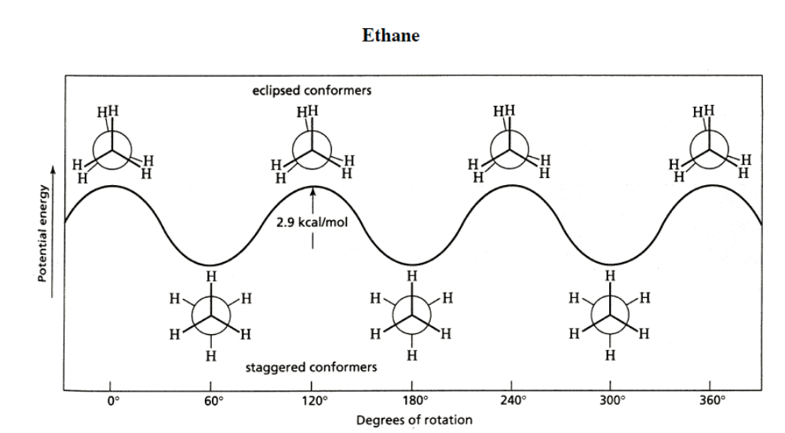

Slide 19
CONFORMATIONAL ANALYSIS OF BUTANE
we consider conformations related by rotation about the bond between the middle two carbons (CH3CH2±CH2CH3). Unlike ethane, in which the staggered conformations are equivalent, two different staggered conformations occur in butane, shown in figure below.
The methyl groups are gauche to each other in one, anti in the other. Both conformations are staggered, so are free of torsional strain, but two of the methyl hydrogens of the gauche conformation lie within 210 pm of each other.
This distance is less than the sum of their van der Waals radii (240 pm), and there is a repulsive force between them. The destabilization of a molecule that results when two of its atoms are too close to each other is called van der Waals strain, or steric hindrance and contributes to the total steric strain.
In the case of butane, van der Waals strain makes the gauche conformation approximately 3.2 kJ/mol (0.8 kcal/mol) less stable than the anti

Slide 20
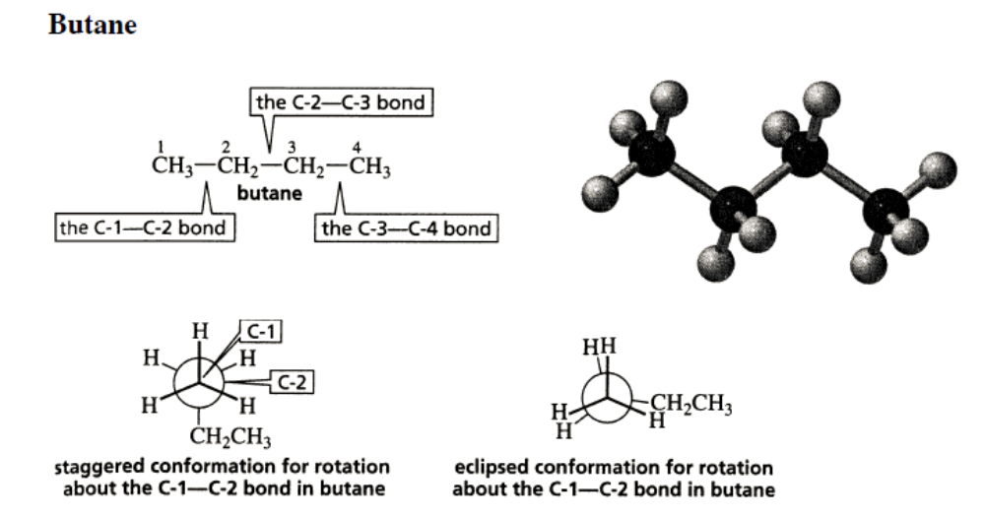

Slide 21
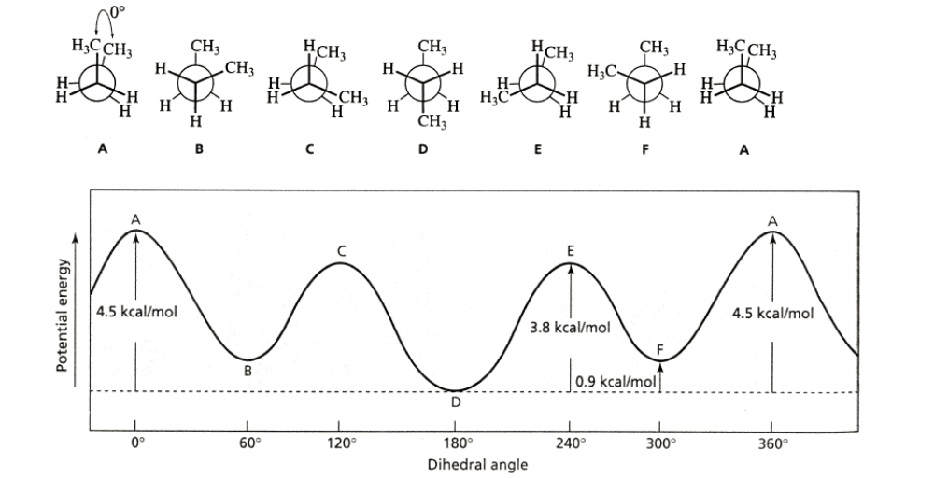

Slide 22
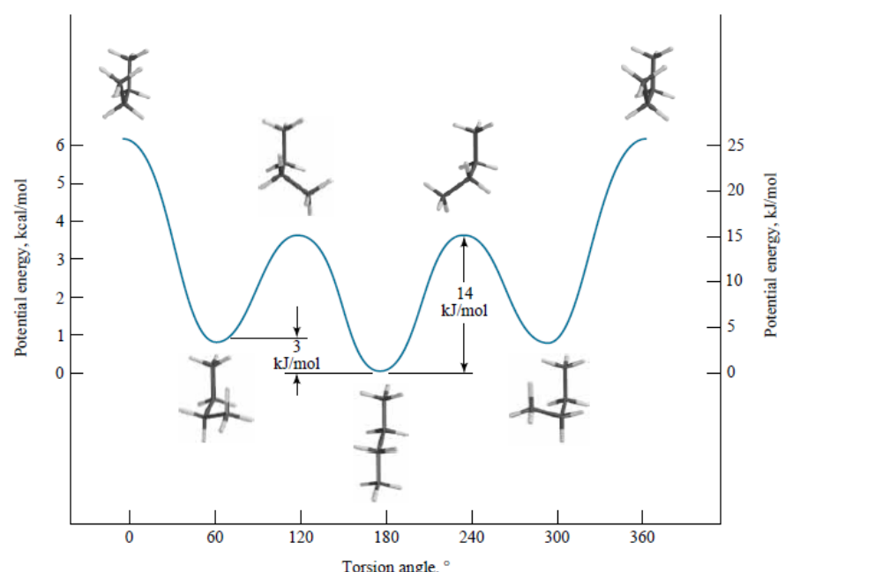

Slide 23
Figure in slide no 22 illustrates the potential energy relationships among the various conformations of butane. The staggered conformations are more stable than the eclipsed.
At any instant, almost all the molecules exist in staggered conformations, and more are present in the anti conformation than in the gauche.
The point of maximum potential energy lies some 25 kJ/mol (6.1 kcal/mol) above the anti conformation. The total strain in this structure is approximately equally divided between the torsional strain associated with three pairs of eclipsed bonds (12 kJ/mol; 2.9 kcal/mol) and the van der Waals strain between the methyl groups.

Slide 24
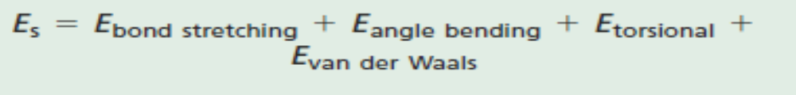
Arithmetically, the total strain energy (Es) of an alkane or cycloalkane can be considered as
where
Ebond stretching is the strain that results when C-C and C-H bond distances are distorted from their ideal values of 153 pm and 111 pm, respectively.
Eangle bending is the strain that results from the expansion or contraction of bond angles from the normal values of 109.5° for sp3 hybridized carbon.
Etorsional is the strain that results from deviation of torsion angles from their stable staggered relationship.
Evan der Waals is the strain that results from “nonbonded interactions.”

Slide 25
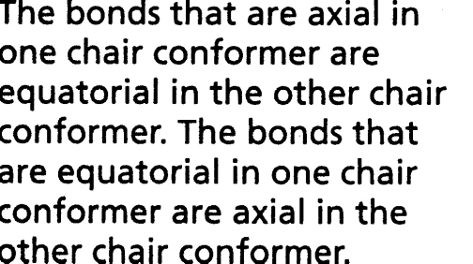
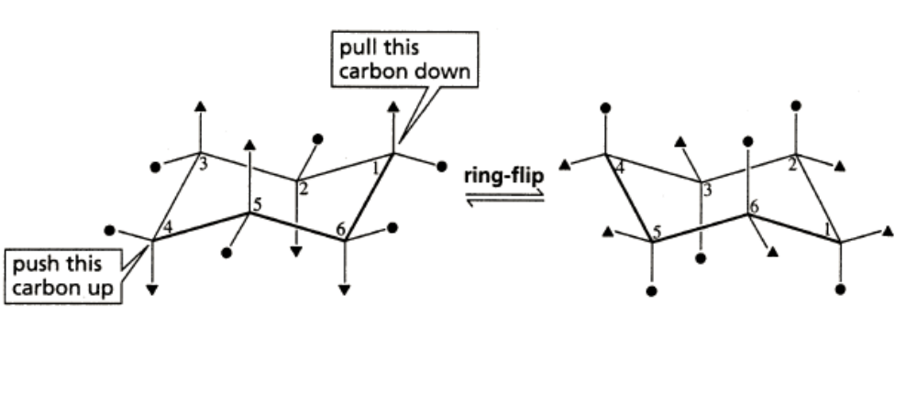
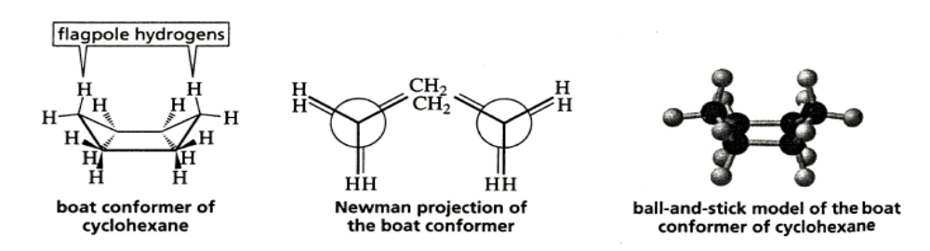
Cyclohexane

Slide 26
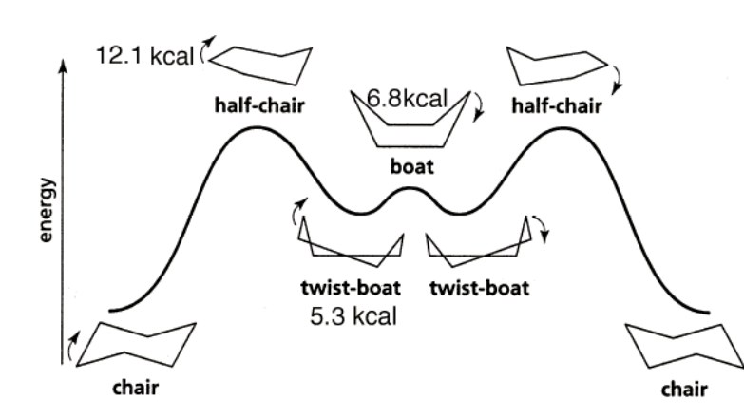
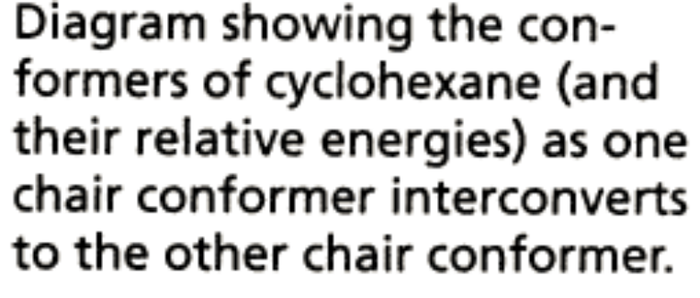

Slide 27
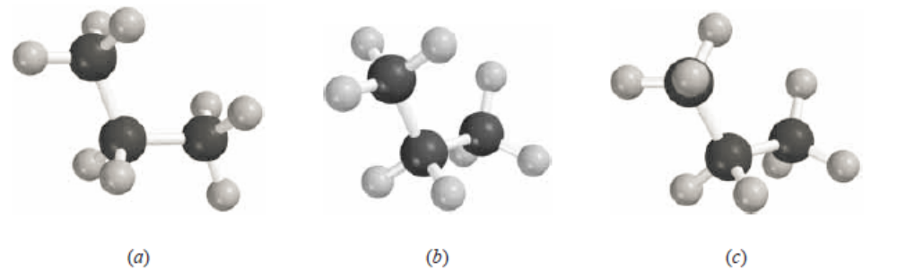
Assignment I (submission 31st January,2018)
Of the three conformations of propane shown, which one is the most stable? Which one is the least stable? Why?
Sight down the C-2±C-3 bond, and draw Newman projection formulae for the
(a) Most stable conformation of 2,2-dimethylbutane
(b) Two most stable conformations of 2-methylbutane
(c) Two most stable conformations of 2,3-dimethylbutane

Slide 28
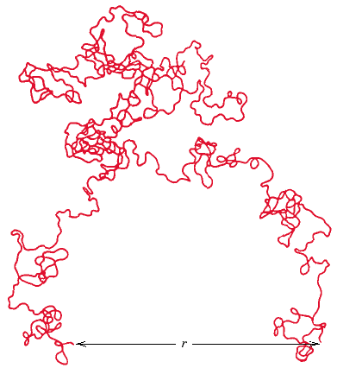
End to End Distance, r
Adapted from Fig. 14.6, Callister 7e.

Slide 29
Configuration
describes the spatial position of atoms within the molecule:
The geometrical arrangement in polymers arising from the order of atoms determined by chemical bonds.
The regularity and symmetry of the side-groups can affect strongly the properties of polymers. Side groups are atoms or molecules with free bonds, called free-radicals, like H, O, methyl, etc.
The configuration of a polymer cannot be altered unless chemical bonds are broken and reformed.
asymmetric C-atom ⇔ all substituents are different

Slide 30
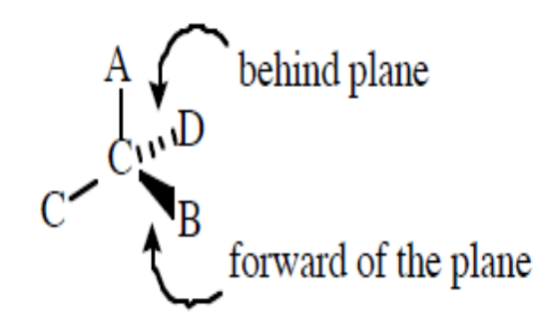
Configurational isomers - separable isomers that do not readily interconvert
chiral centers - absolute stereochemistry
sp3 carbons (or nitrogens, or ...)
chiral-handed (left or right)
enantiomers (enantio = opposite)
non-identical (non-superimposable) mirror image
R = recto (right-handed)
S = sinestro (left-handed)

Slide 31
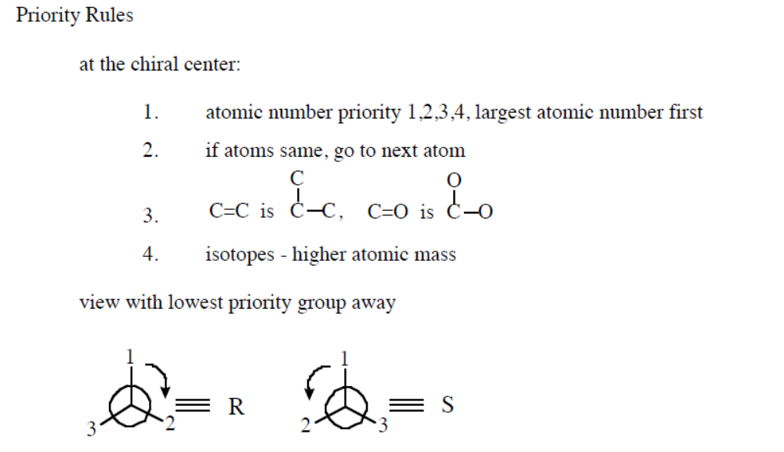

Slide 32
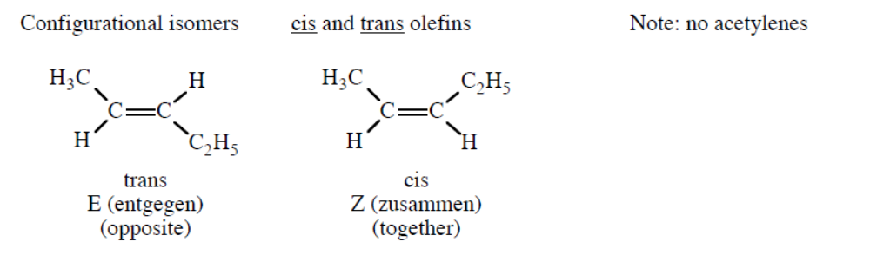
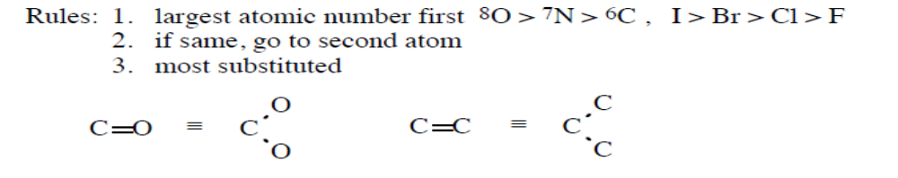
Configurational isomers - separable isomers that do not readily interconvert. Most would require "breaking" and "making" of bonds.
a. cis-trans (olefins)
b. chiral centers - absolute stereochemistry

Slide 33
Molecular Structures
Covalent chain configurations and strength:
secondary
bonding
Linear
B
ranched
Cross-Linked
Network
Direction of increasing strength
Adapted from Fig. 14.7, Callister 7e.

Slide 34
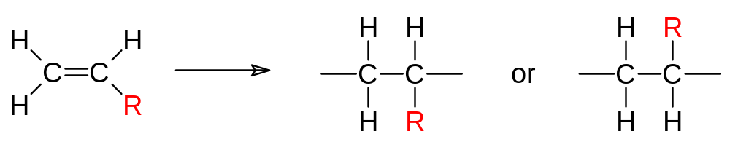
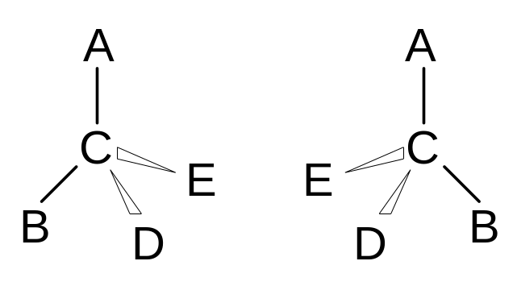
Polymers – Molecular Shape
Configurations – to change must break bonds
Stereoisomerism
mirror plane

Slide 35
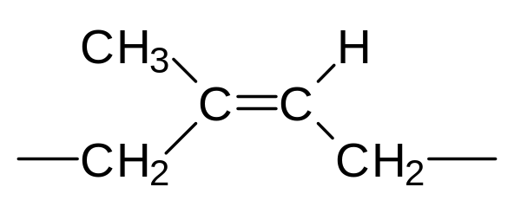
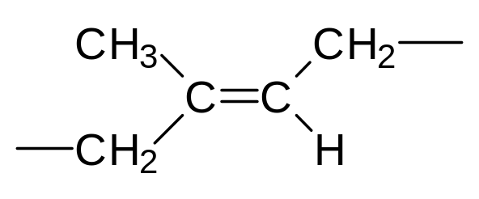
cis/trans Isomerism
cis
cis-isoprene
(natural rubber)
bulky groups on same side of chain
trans
trans-isoprene
(gutta percha)
bulky groups on opposite sides of chain

Slide 36
Assignment II (submission 31st January,2018)
What is the difference between configuration and conformation (use examples)?
Which configurational isomers are important for polymers? Which ones are likely to form crystalline structures?

Slide 37
Extra Reading on Conformation and Configuration…..
http://slideplayer.com/slide/8459490/
http://ocw.polytechnic.edu.na/courses/materials-science-and-engineering/3-091sc-introduction-to-solid-state-chemistry-fall-2010/organic-materials/28-polymers-structure-composition/
https://www.youtube.com/watch?v=yWwxFmyZNfg
http://slideplayer.com/slide/4395311/
http://www.open.edu/openlearn/science-maths-technology/science/chemistry/introduction-polymers/content-section-2.3.3#fig002-004

Slide 38
About NR and Gutta Percha
Gutta Percha and Natural rubber (Refer Goodman1974thermopropertiesGP.pdf)
https://books.google.co.in/books?id=0X4cQus2gz8C&pg=PA659&lpg=PA659&dq=why+gutta+percha+is+more+crystalline&source=bl&ots=66tJvleCyL&sig=FiRdLfKw6Ym52AobJKzA94RY3KI&hl=en&sa=X&ved=0ahUKEwj8sjBpeHYAhWJvI8KHVCGBaMQ6AEIVDAF#v=onepage&q=why%20gutta%20percha%20is%20more%20crystalline&f=false

Slide 39
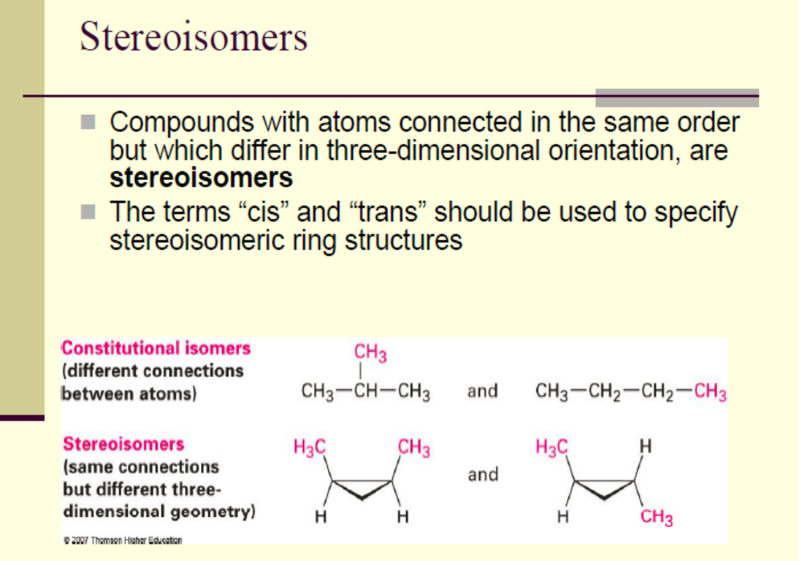

Slide 40
Tacticity:
The orderliness of the succession of configurationally repeating units in the main chain of a polymer molecule (important for crystallization).
if the radicals are linked in the same order, the configuration is called isotatic
in a stereoisomer in a syndiotactic configuration, the radical groups are at alternative sides in the chain
in the atactic configuration, the radical groups are positioned at random

Slide 41
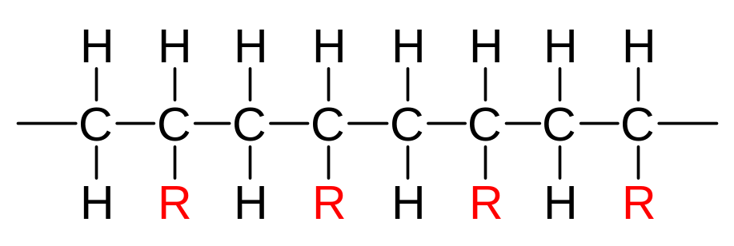
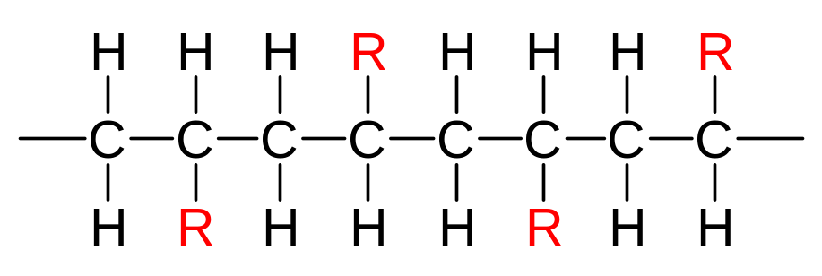
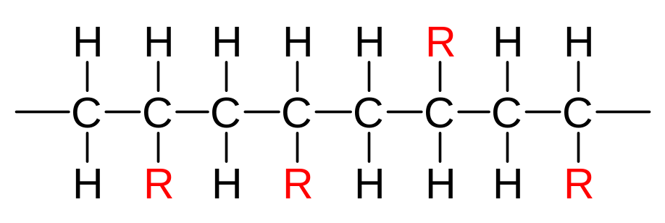
Tacticity
Tacticity – stereoregularity of chain
isotactic – all R groups on same side of chain
syndiotactic – R groups alternate sides
atactic – R groups random

Slide 42
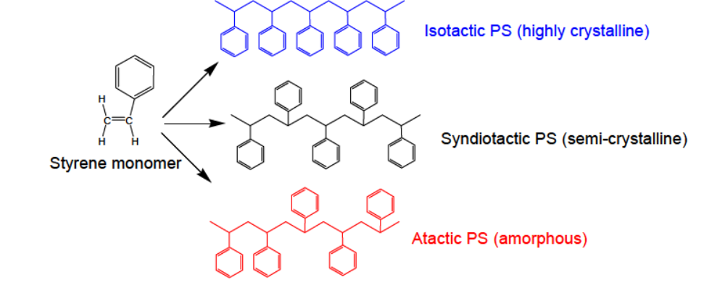

Slide 43
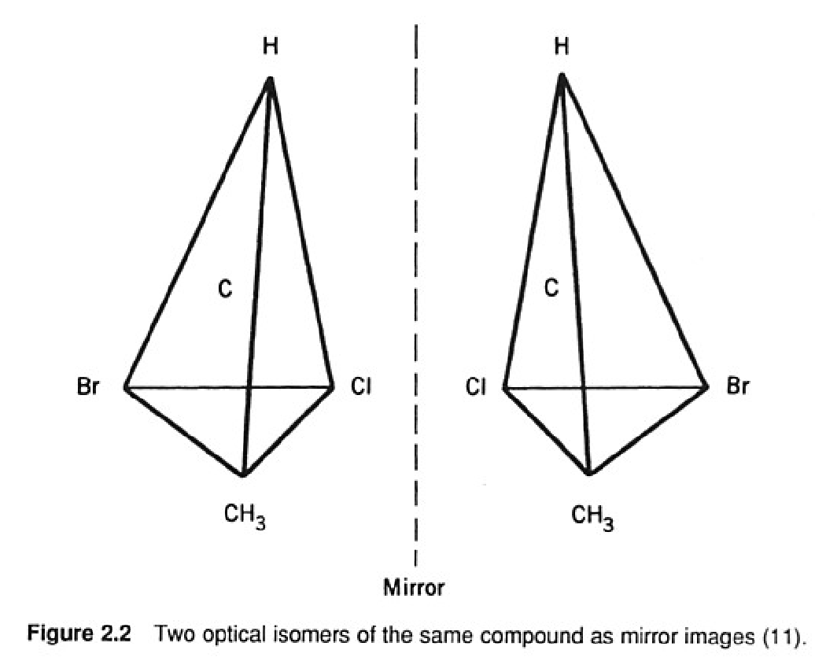
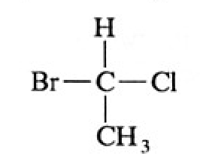
Stereochemistry of repeating units
Chiral centers
*
Chemically identical but they rotated plane-polarized light in opposite directions.

Slide 44
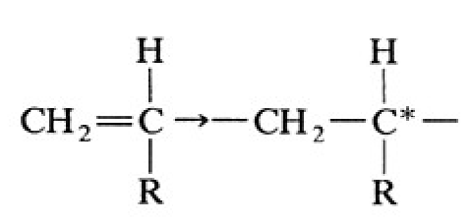
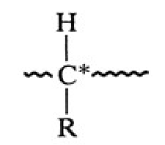
Tacticity in polymers
Polymerization of monosubstituted ethylene
Pseudochiral center

Slide 45
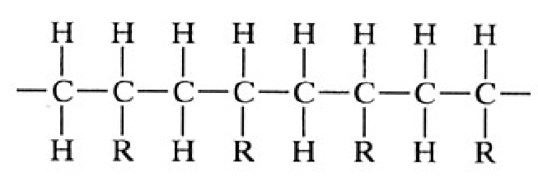
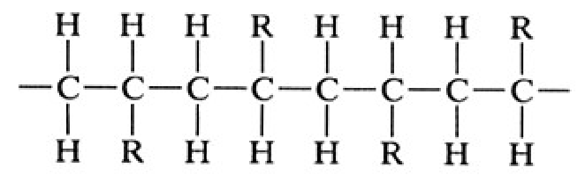
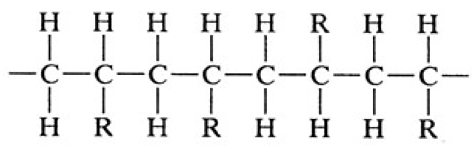
isotactic
syndiotactic
atactic

Slide 46
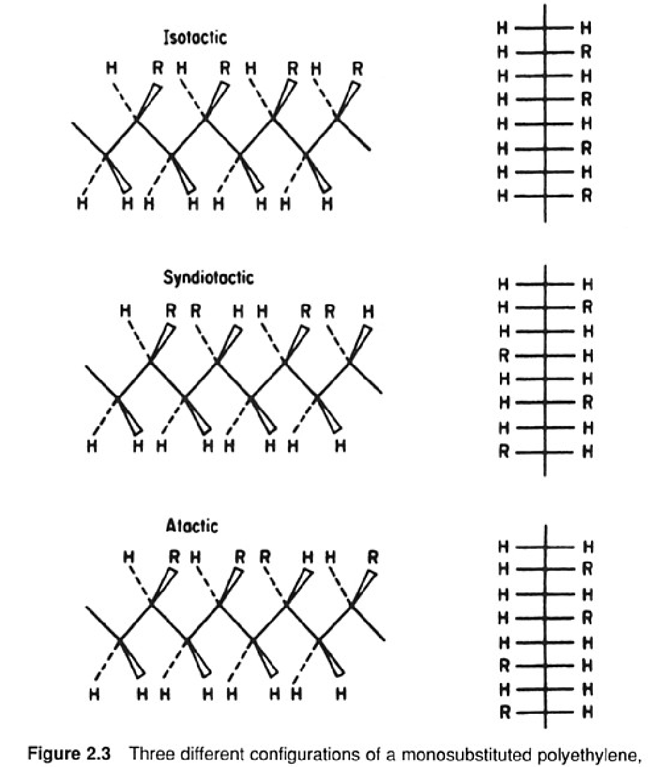

Slide 47
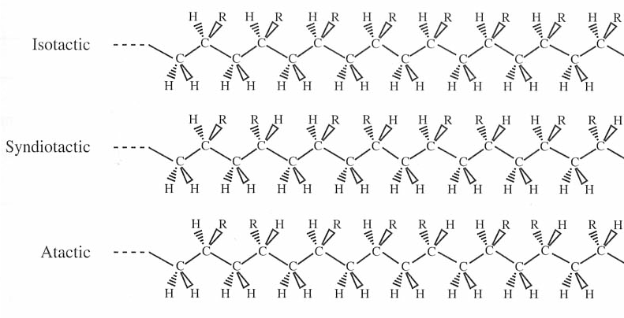
Stereo-isomers

Slide 48
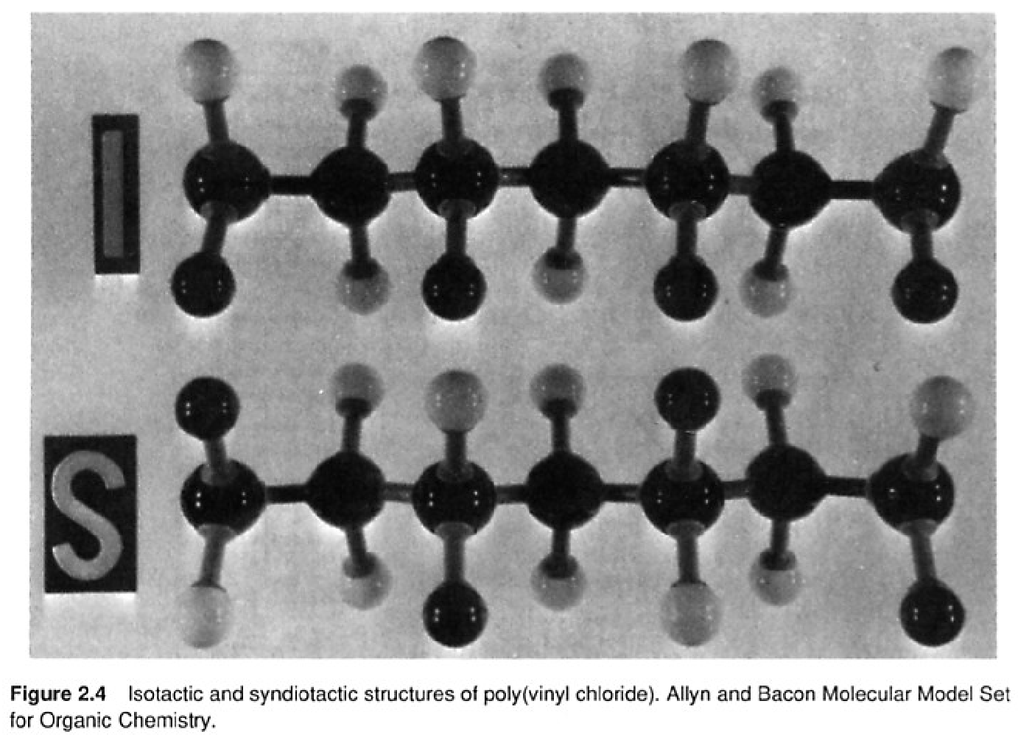

Slide 49
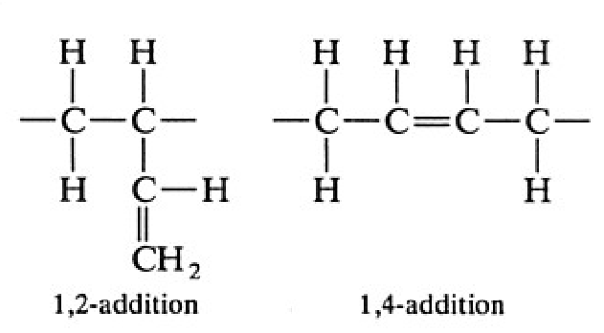
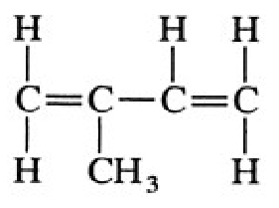
2.4.3 Substitutional isomerism
Synthesis of diene type polymers
1,2
1,4
3,4
addition polymerization
isoprene

Slide 50
Extra Reading on Stereoisomerism
http://www.open.edu/openlearn/science-maths-technology/science/chemistry/introduction-polymers/content-section-2.3.4

Slide 51
Thank You

